Slide 1


Govans Elementary PTO
27 September 2022
Brandon M. Scott
Mayor
Chris Ryer
Director

Slide 2

Investing in Schools + Neighborhoods
City Schools, Maryland Stadium Authority, Baltimore City, and the State are investing nearly one billion dollars to renovate or replace schools.
21st Century has 3 goals:
Transform student opportunities and achievement
Improve engagement and wellbeing of communities
Help revitalize neighborhoods and communities
The Planning Department launched the INSPIRE program to focus on the neighborhood immediately surrounding each of the 21st Century schools.
Concentrate improvements around the school:
Improve the environment and quality of life
Take concrete action towards the community’s long-term vision; guide private investment
Notes:
21st Century was in place - many people recognized importance of using the investments and momentum around the schools to catalyze other positive neighborhood changes.
That’s how DOP came to launch INSPIRE (which stands for Investing in Neighborhoods and Schools to Promote Improvement Revitalization and Excellence).
INSPIRE is a process that results in a plan that is adopted by the Planning Commission. Like other plans, the bulk of the document is a series of recommendations that focus on improvements in the environment and QOL of students, their families, and neighborhood residents and businesses.
INSPIRE does not focus on a large area. It focuses primarily on the ¼-to-1/2 mile around each of the 21st Century schools.

Slide 3
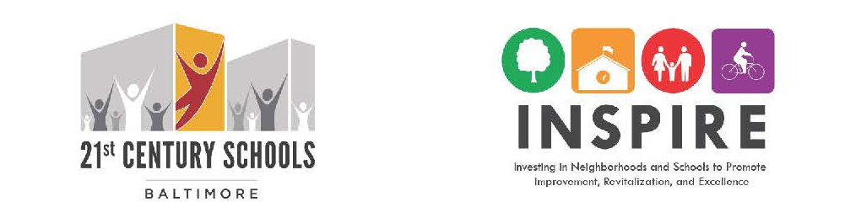
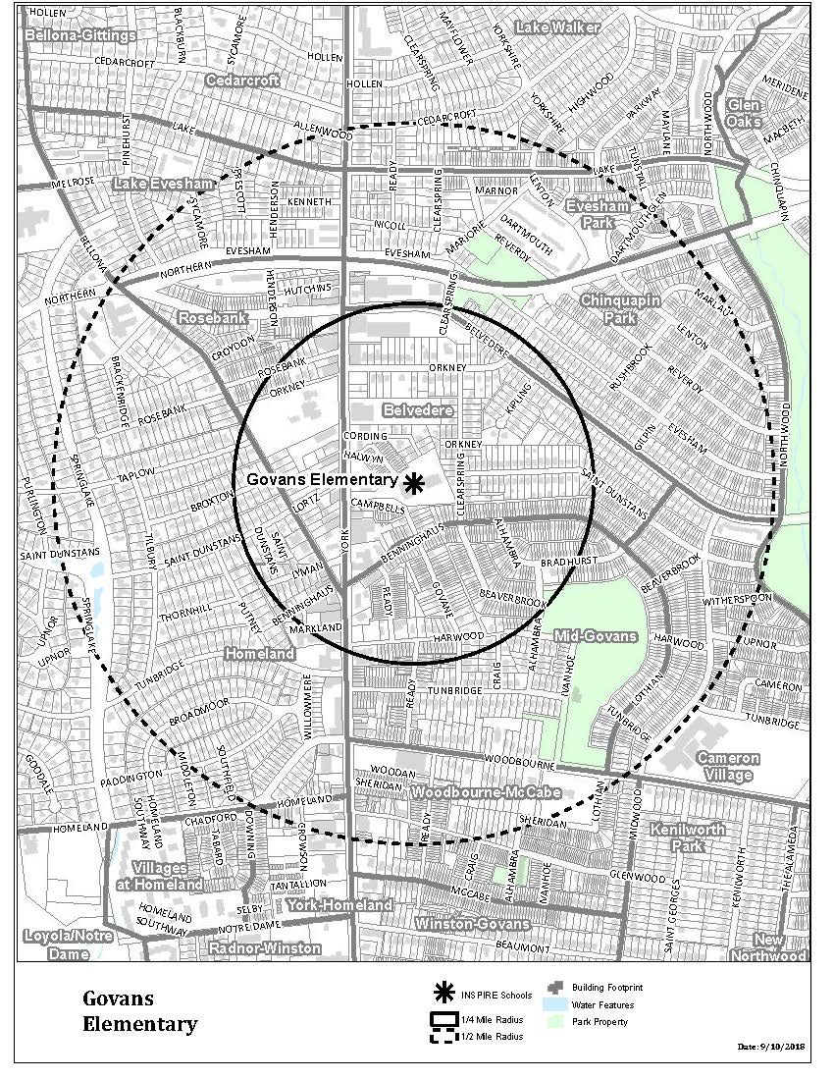
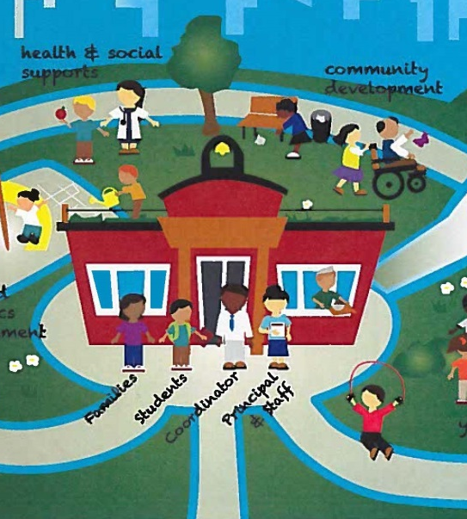
There’s a Lot Being Planned/Happening…
COMMUNITY
SCHOOLS
School Site
(City Schools)
Around the School
(Dept. of Planning)
Partners & Resources
(Family League)
Notes:
Multiple programs with a similar goal = strong school/strong neighborhood, but different timelines and processes. Unique opportunities…
21st Century Schools
About designing a school site that supports excellence in teaching and learning, and provides communities with a shared public resource. The school building, the site, student, school transportation – that’s all part of 21st Century.
INSPIRE
About using the momentum around school construction to improve the environment and quality-of-life for students, their families, and neighborhood residents and businesses around each 21st Century school building.
Community Schools
About providing supplemental programming, services, and partners for students and families, based on a needs assessment and action plan.

Slide 4
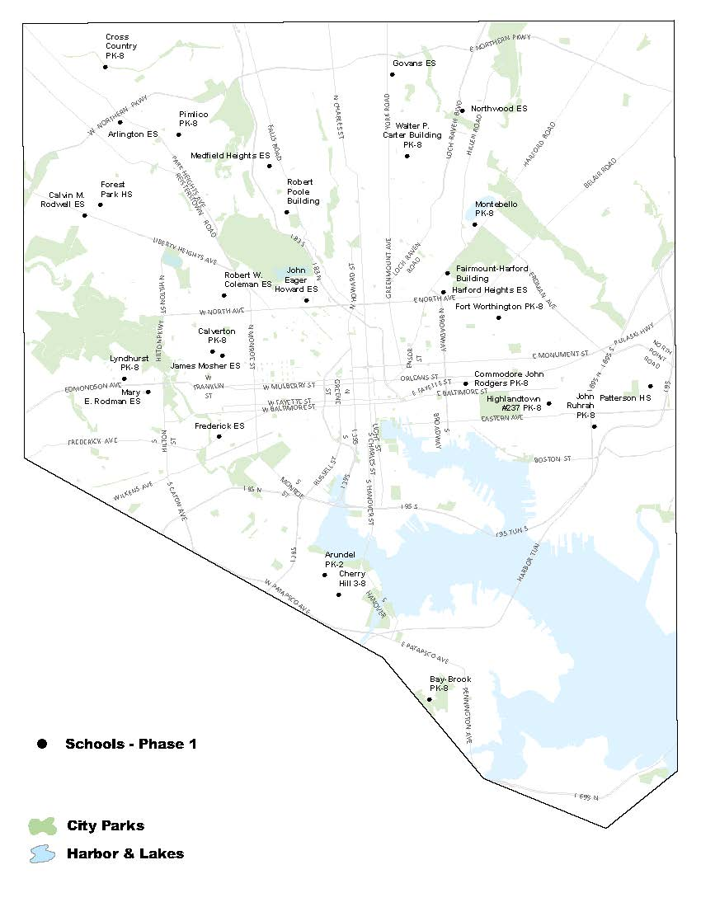
Rolling-out INSPIRE Citywide→ Area Specific

Slide 5
INSPIRE: What It Is (Overview)
A plan
  Improve quality of life and guide community’s long-term vision
  Recommendations for short-and long-term activities and investments
  Adopted by the Planning Commission
  City investments
  Community-based/public space project
A process to develop and begin to implement the plan
  Gather information
  Draft and review recommendations
  Write, review, and implement
Notes:
Remaining slides get into more detail…And we’ll get into much more detail in future workshops/activities.

Slide 6
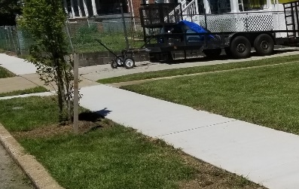
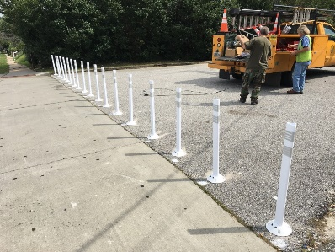
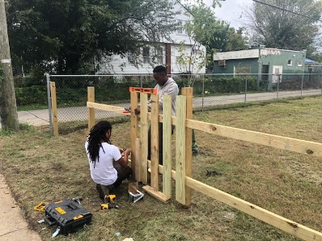
Activities, Investments, Recommendations
Preparing for Opening Day
City agencies have committed to streetscape improvements (sidewalk repairs, crosswalks, street trees, etc.).
Where: Along the Primary Walking Routes
Area-Specific Recommendations
Improvements in the environment and QOL of students, their families, and neighborhood residents/businesses (housing market and development; safety; sanitation; sustainability; health, wellness, and recreation; transportation; and self sufficiency).
Where: Throughout INSPIRE area, nearby
Community-Selected Priority Project
INSPIRE funds implementation of one of the recommendations.
Where: Throughout INSPIRE area

Slide 7
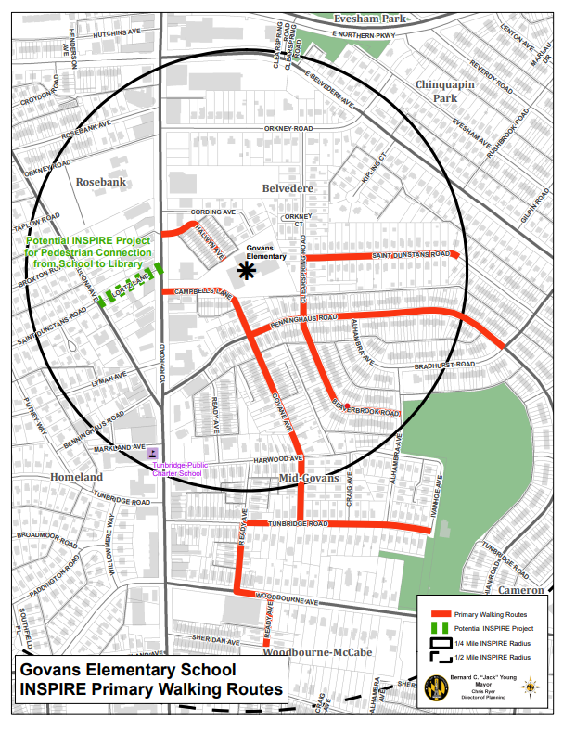
Recommendations: Primary Walking Routes
Preparing for Opening Day
City agencies have committed
to making these improvements:
Repairing sidewalks
Repainting or adding crosswalks
Marking Safe Routes to School
Assessing crossing guard deployment
Pruning & planting street trees
Replacing missing/broken lights
Boarding open vacant buildings
Picking up trash and maintaining vacant lots
Notes:
One set of recommendations focuses on physical improvements along designated walking routes. These are the standard improvements that will be the same across all of the areas, and that will be made prior to opening day of the modernized school. Paid for with GO bonds and City agency capital budget.
The routes are developed with input from principals, community school coordinators, teachers, students, parents, and other community members. ID the major routes children take to get to school, paying particular attention also to where students previously zoned for a closing school will be coming from.

Slide 8
Recommendations: Quarter-Mile around the School
Housing & Market Strength: Have diversity in housing type, housing quality; remove blight; focus on retail and other development
Environmental Sustainability: Improve the natural environment
Transportation: Connect people to the places they need and want to go
Sanitation: Have clean sidewalks, vacant lots, alleys, and other areas
Improve Safety: Make people feel and be safe
Health and Wellness: Ensure there are places for people to recreate, play, and come together; provide better access to healthy foods
Economic Self-Sufficiency: Expand employment and workforce development opportunities
Notes:
General categories: Process will lift up priorities in the communities around the school. It’s not a large-scale plan, but will be impacted by, and fits into the context of, current and planned activities.

Slide 9
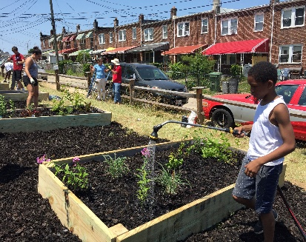
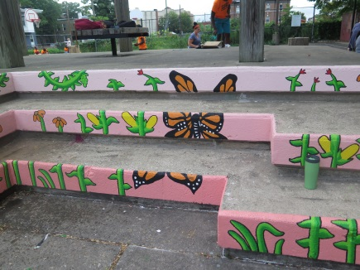
Implementation: Examples
A community organization near Arlington Elementary, and faculty & students at Fort Worthington, are adopting City-owned lots and turning them into a community/school gardens.
INSPIRE and BRNI funding is implementing a new park master plan near Dorothy I. Height Elementary, which will include new lights, new playground equipment, and landscaping and beautification upgrades.
Notes:
Other: Worked with DOT to apply for a state Safe Routes to School grant (Pimlico)

Slide 10
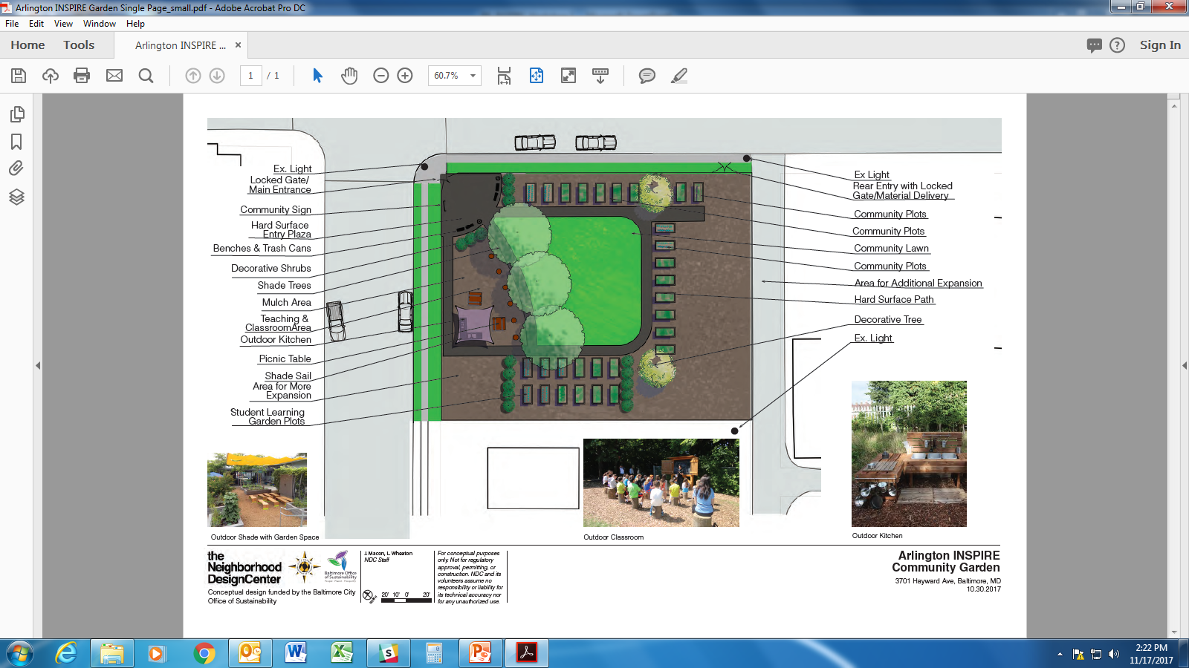
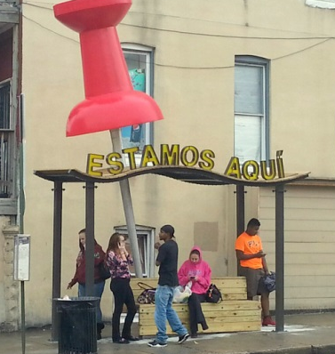
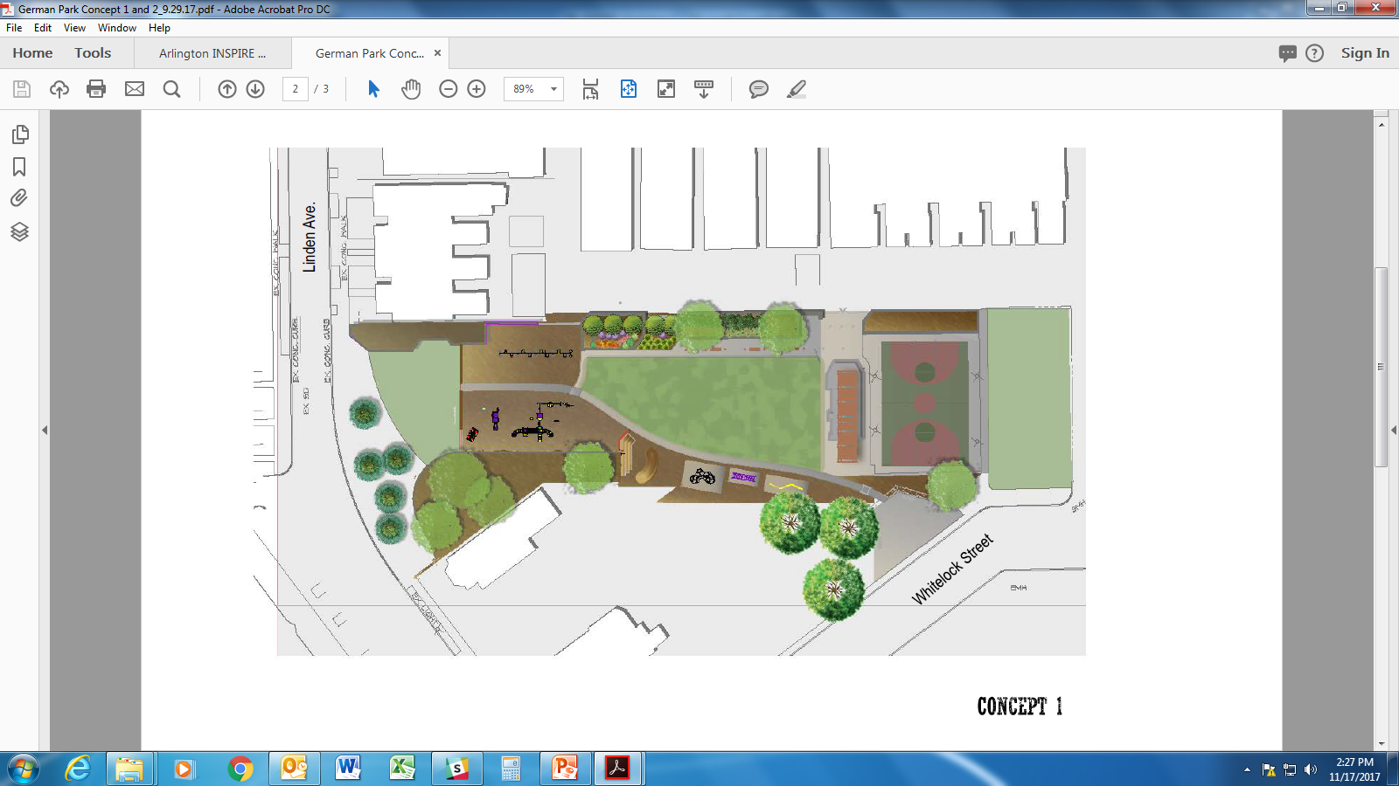
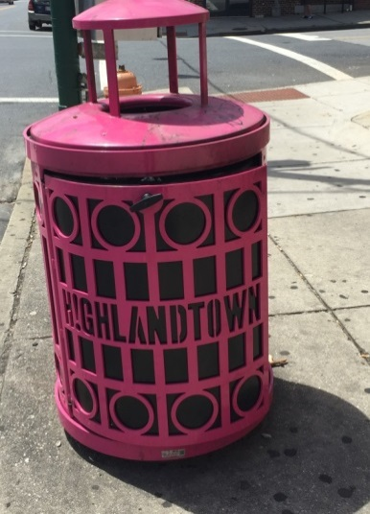
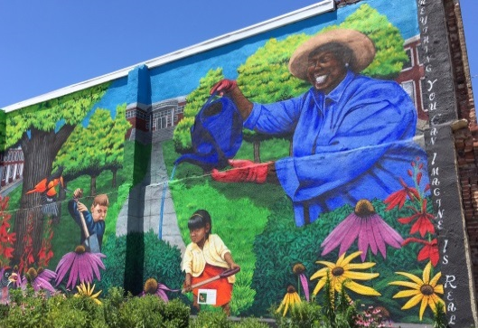

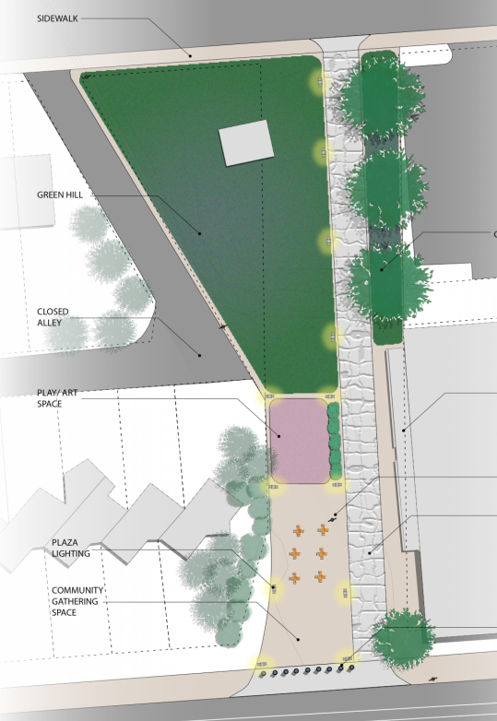
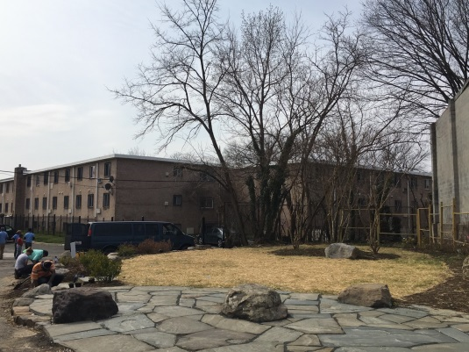
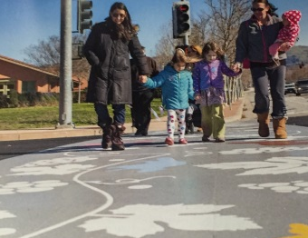
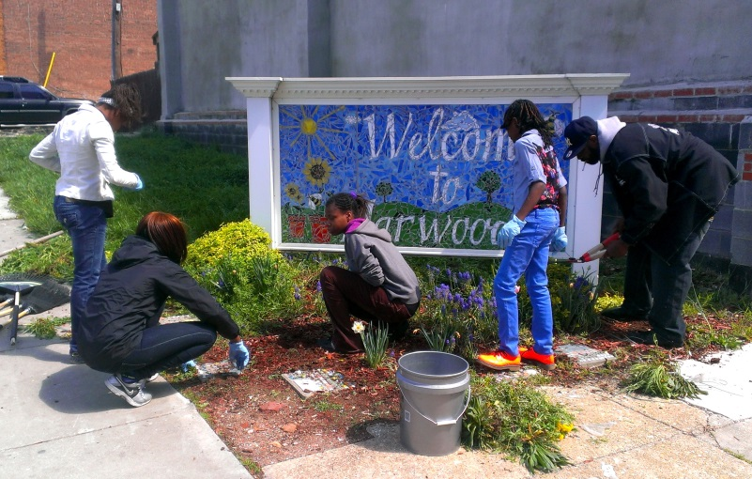
Community-based Projects: Examples
Notes:
As part of INSPIRE we have funding to work with the community to develop a special project in the INSPIRE area. Examples:
Learning Gardens, Bus Shelters, Community Signs, Play Spaces, Park Improvements, Murals, Public Art, Artistic Fencing, Traffic Calming, Façade Improvement, Artistic Crosswalks, Unique trash receptacles

Slide 11
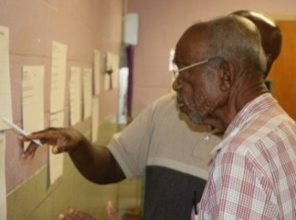
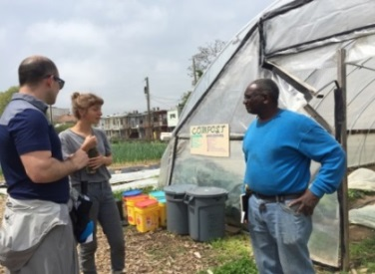
Process = Engagement + Implementation
LISTEN: GATHER INFORMATION
CREATE: DRAFT & REVIEW RECOMMENDATIONS
DELIVER: FINALIZE & IMPLEMENT PLAN
Workshops, Surveys, Steering Committee Involvement,
“Field work” (community walks)
DOP Drafts, City Agency Involvement,
Steering Committee Involvement, Workshops
DOP Finalizes , Shares with Community, Presents to Planning Commission, Implements
COMMUNITY ENGAGEMENT
INSPIRE Workshops
Community Meetings & Events
Steering Committee Meetings
School Events
Student Workshops & Projects
Fieldwork/Community Walks
Subject-area Workshops
Project Voting
Project Charrettes
Although much of the plan will be implemented after adoption, there is investment and activity throughout the process.
Notes:
Constituencies and Partners: Residents, Community Organizations, and Businesses; City Agencies; Baltimore City Public Schools/21st Century, Family League; School Leadership, Students; Philanthropic Community; Elected Officials; Development Sector; Anchor Institutions; Citywide Organizations

Slide 12
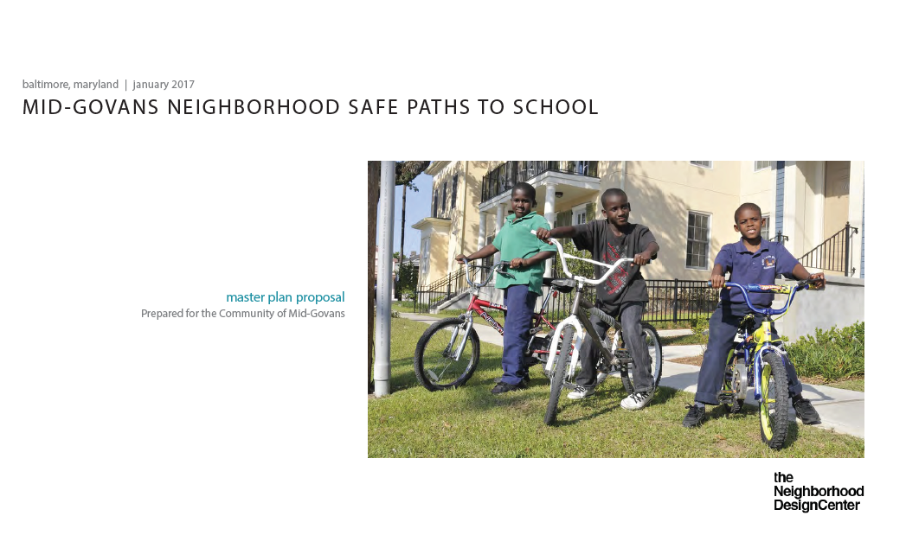
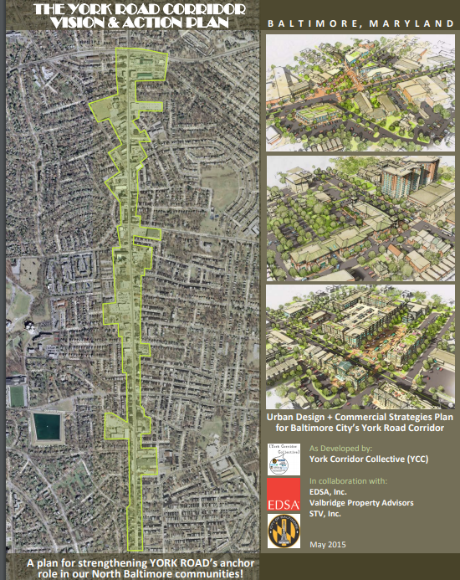
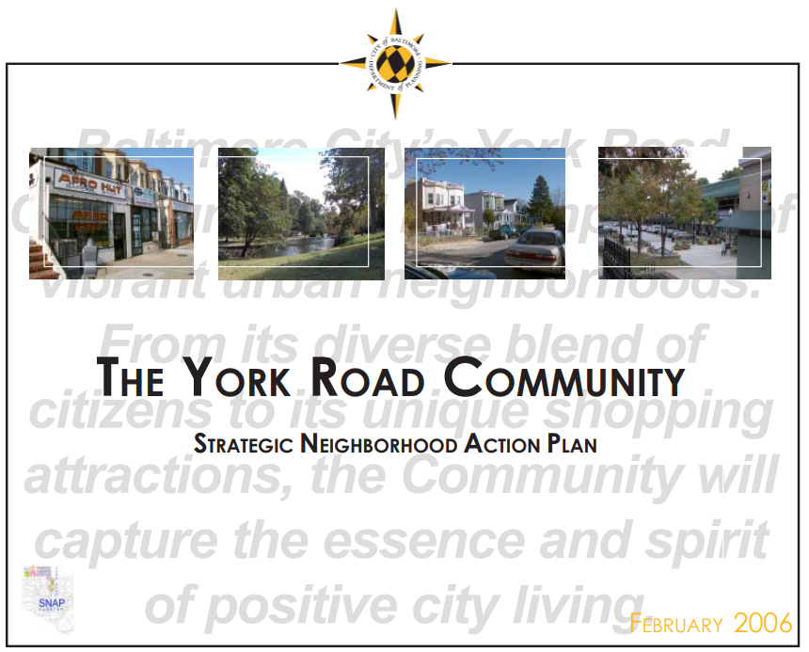
REVIEW OF PLANS

Slide 13
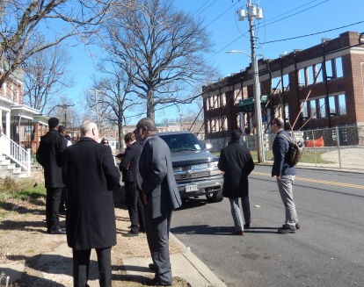
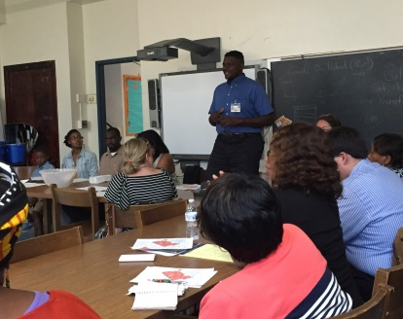
INSPIRE Steering Committee
A small Steering Committee of community volunteers will work closely with INSPIRE process and serve as ambassadors.
Listen
  Outreach
  Introductions
  Share important history/priorities
  Community Walks
Create
  Recommendation prioritization and feedback
  ID subject-area workshop interest
Deliver
  Community-based project participation
  Planning Commission participation
  Please sign up if you’re interested in participating!
Notes:
A small steering committee will act a “ambassadors” for the program and work with us more closely. Here’s how you can be more involved.
We’ll have our first SC meeting over the summer, then step-up frequency in the fall.

Slide 14
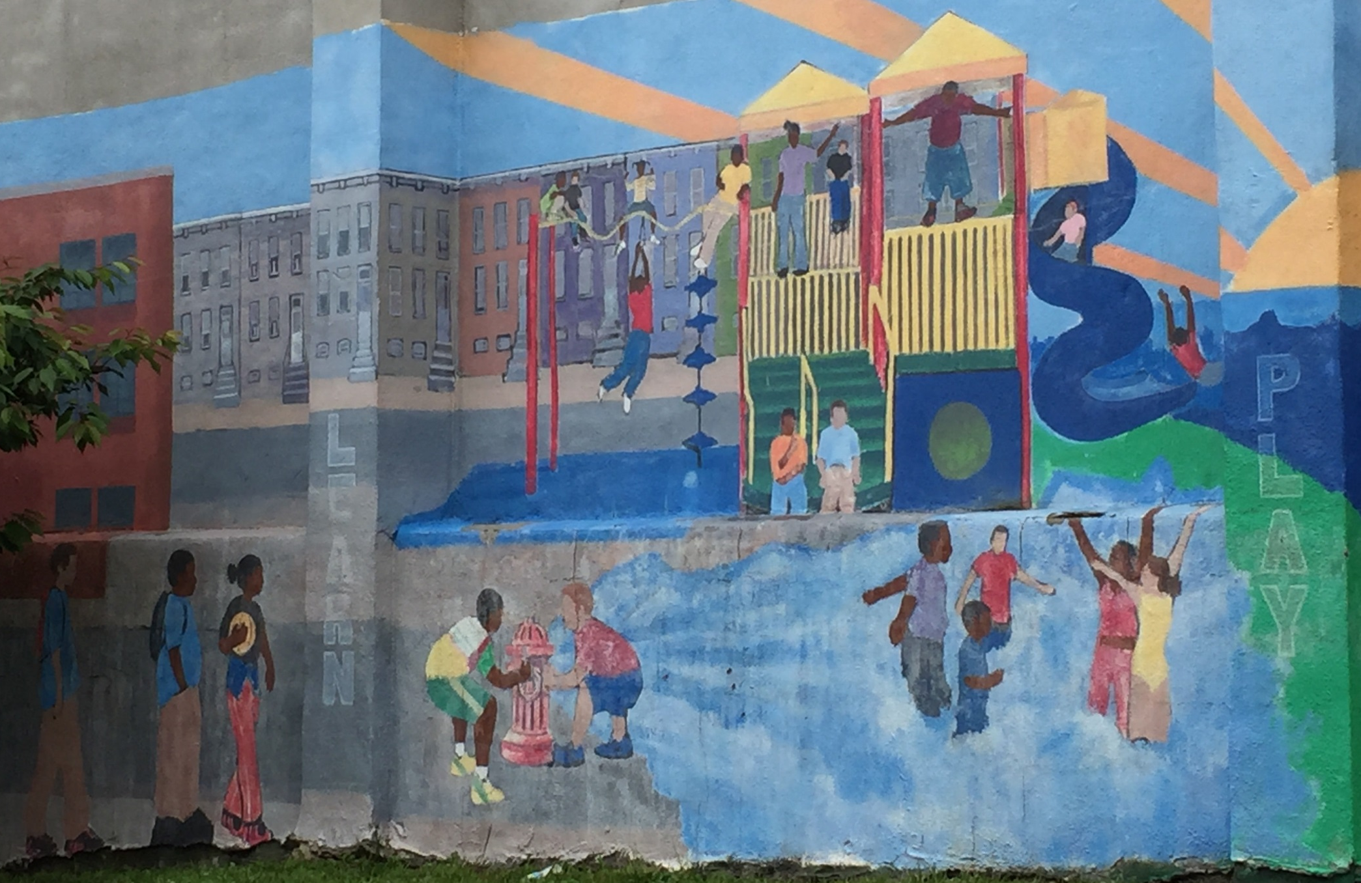
Contact Information and Next Steps
Jaffa Batya Weiss, INSPIRE Planner
jaffa.weiss@baltimorecity.gov
410.396.5937
Marie Anderson, Northern District Planner
marie.anderson@baltimorecity.gov
410.396.3957
Upcoming Meetings and Events
Walk of the Govans INSPIRE Area – Tuesday, October 6

